Slide 1
Excitation-Inhibition Balance of Cortico-Striosomal Circuit is Critical for Regulation of Normal and Aberrant Decision-Making
Alexander Friedman and Sabrina Drammis McGovern Institute for Brain Research Massachusetts Institute of Technology
March 5, 2018
Notes:
Thank you for invating,
We will discuss role of striaosomal compartment of striatum in decision making
1

Slide 2
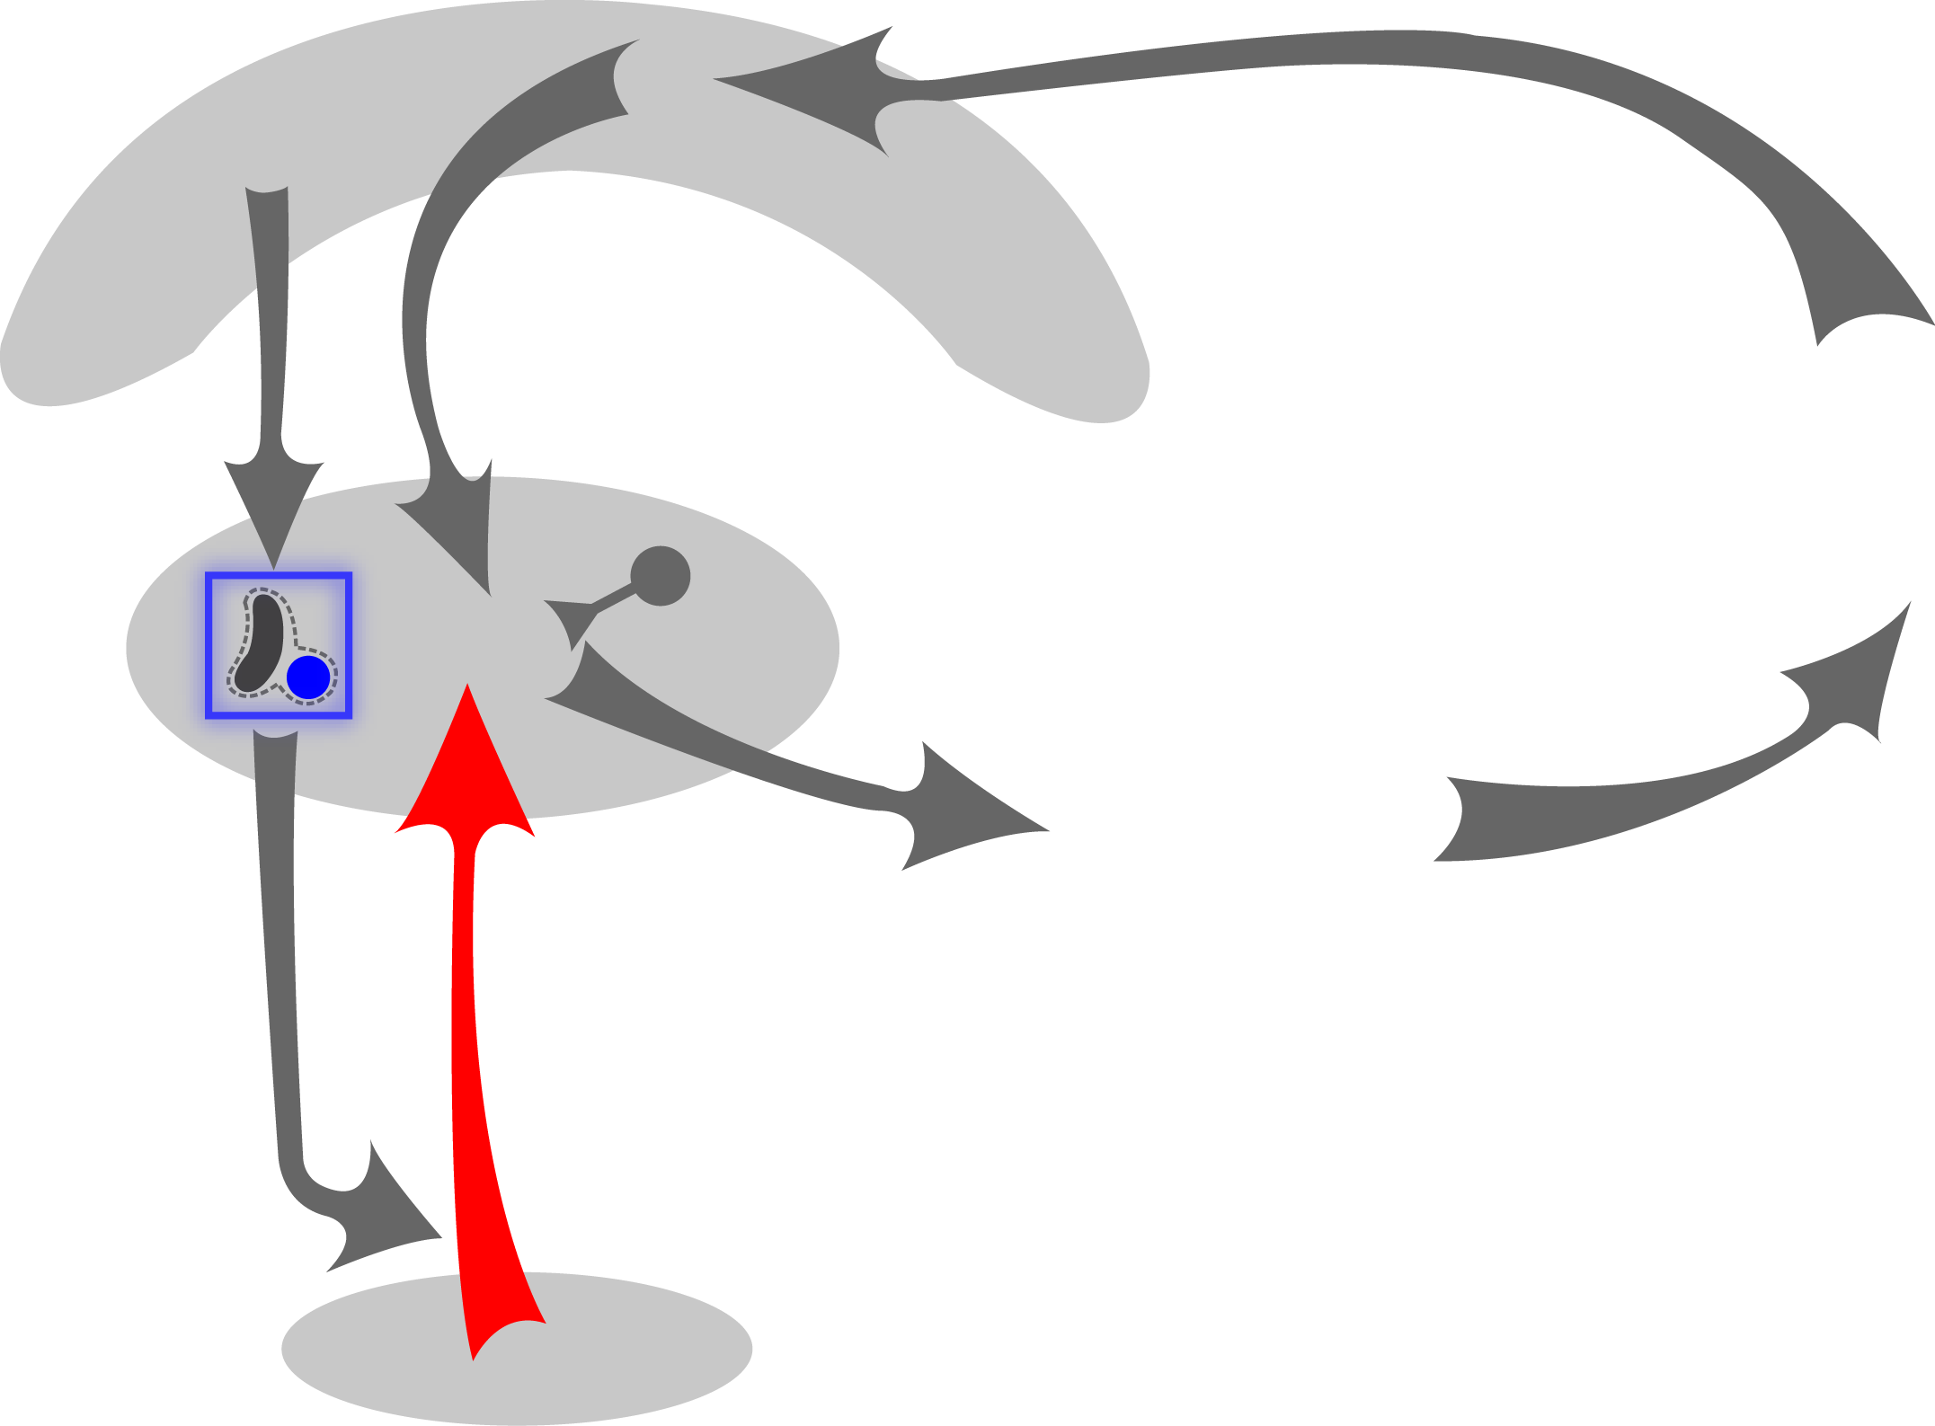
Neocortical and Striatal Circuits in Evaluation, Decision-Making and Disorders
Neocortex
Motor plus
Parkinson’s disease
Huntington’s disease
Dystonia
Striatum
DECISION
Neuropsychiatric
Repetitive Behaviors
OCD/Tourette/ASD
Mania/Depression
Dopamine
Substantia Nigra
Notes:
When I start learn discion making as a person trained in computer science I ask my self what are critical brain regions that are involved in decion making

Slide 3
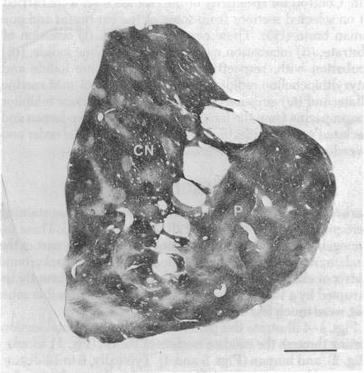
Striosome and Matrix Compartments of the Striatum
Striosomes function ?
Technical limitations…
Notes:
Here I am showing u
3

Slide 4
Neocortical and Striatal Circuits in Evaluation, Decision-Making and Disorders
Evaluation
Striosomes
Interneurons
Neocortex
DECISION
Striatum
Pallidum
S. Nigra
LHb
Raphe
Serotonin
Dopamine
Notes:
I will demonstrate you how disorder like chronic stress shift dynamic corticostriosomal circuit and effect decion making similar to optogenetic ddisconection of PFC from Striatum

Slide 5
Striosome-Projecting Cortical Regions Related to Mood and Anxiety Disorders Affect Decision-Making
Human findings implicate these regions in drug-responding types of depression and anxiety
And approach-avoidance conflict paradigms can be discriminative
(Pizzagalli et al., 2011)
Benzodiazepam
Millan and Brocco (2003)
Notes:
Offer ? Combination
Year 1968

Slide 6
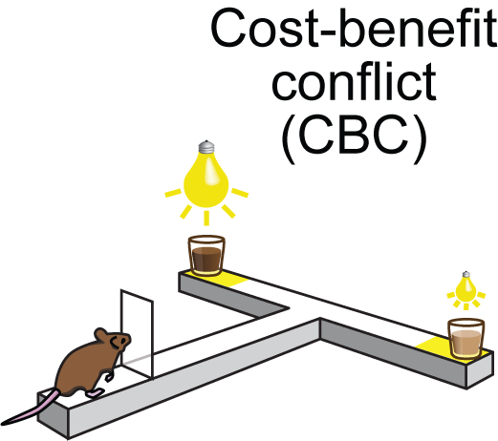
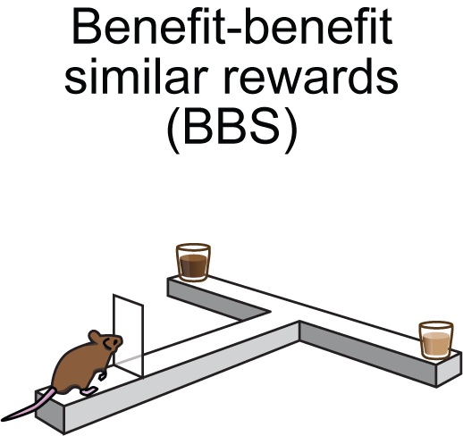
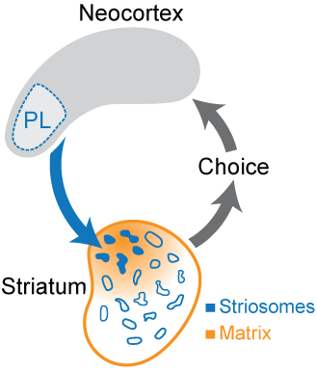
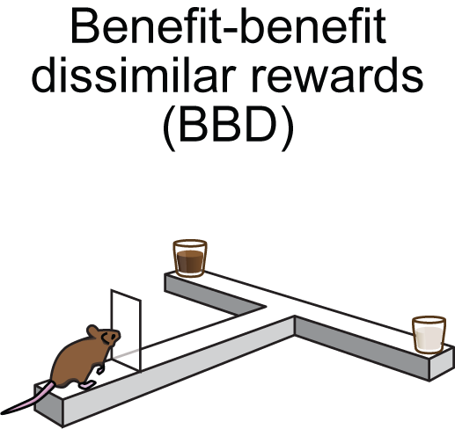
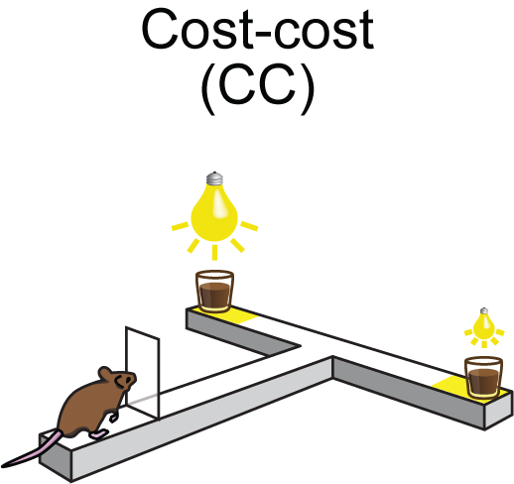
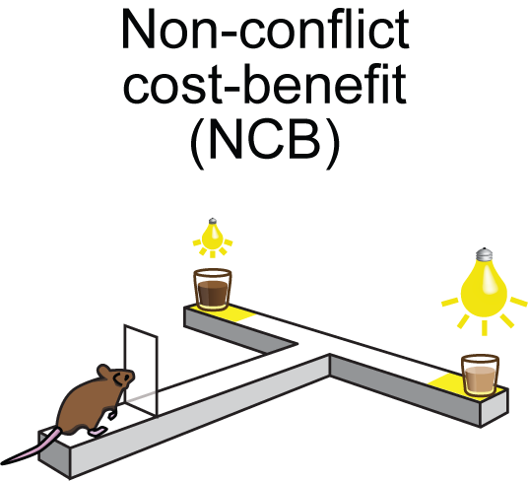
Behavioral Tasks
Friedman et al., Cell (2015)
Notes:
Transperent background
6

Slide 7
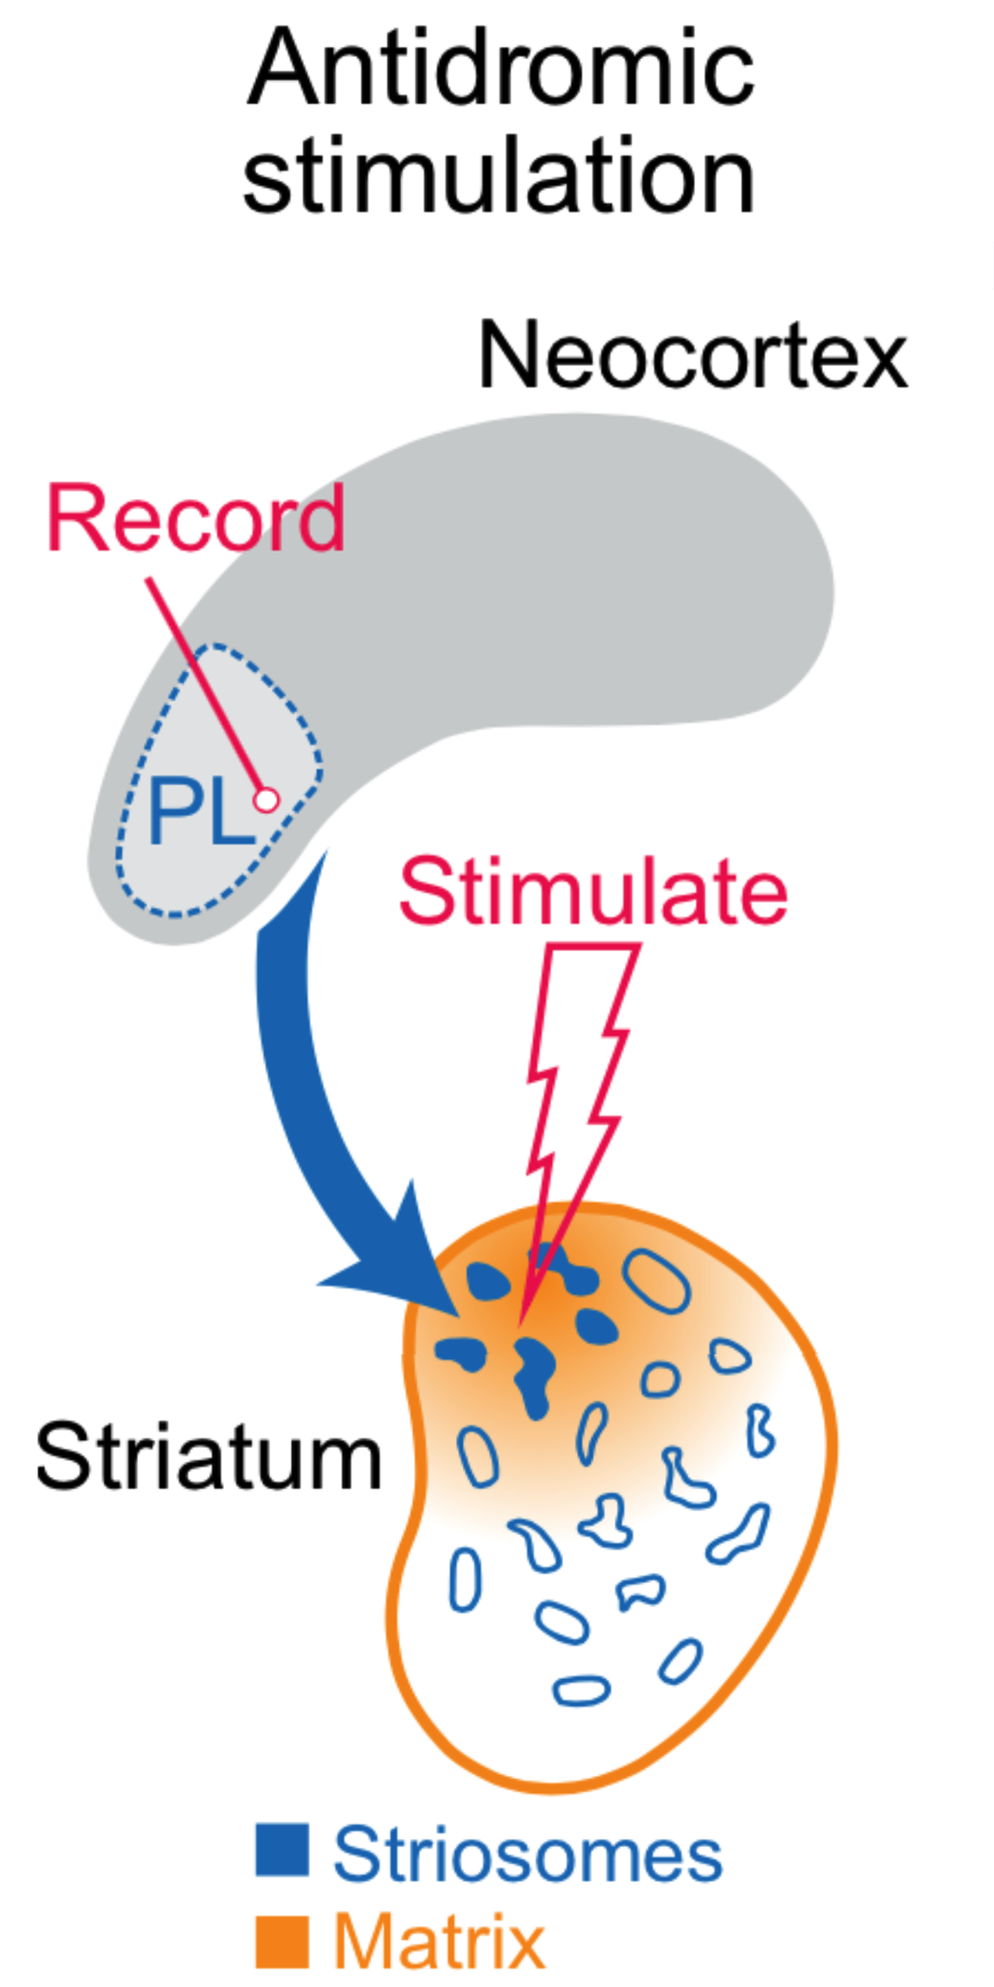
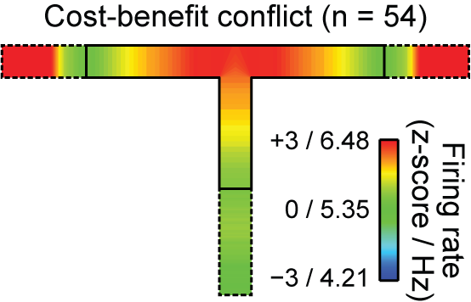
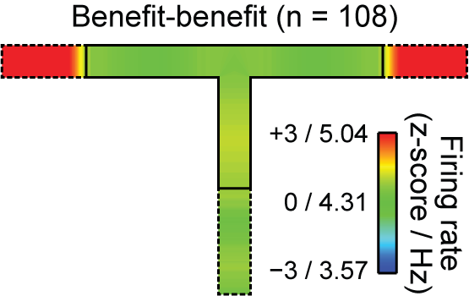
Can We Dissect The Corticostriatal Circuit Mechanisms Underlying These Optogenetic Effects?
Friedman et al., Cell (2015)
Notes:
1) explain unique subpopulations.
2) Explain maze Maze and space –time
3) Red is high activity..
4) Interpret result- red in CB but green in in BB mean PLS Active during CBC run

Slide 8
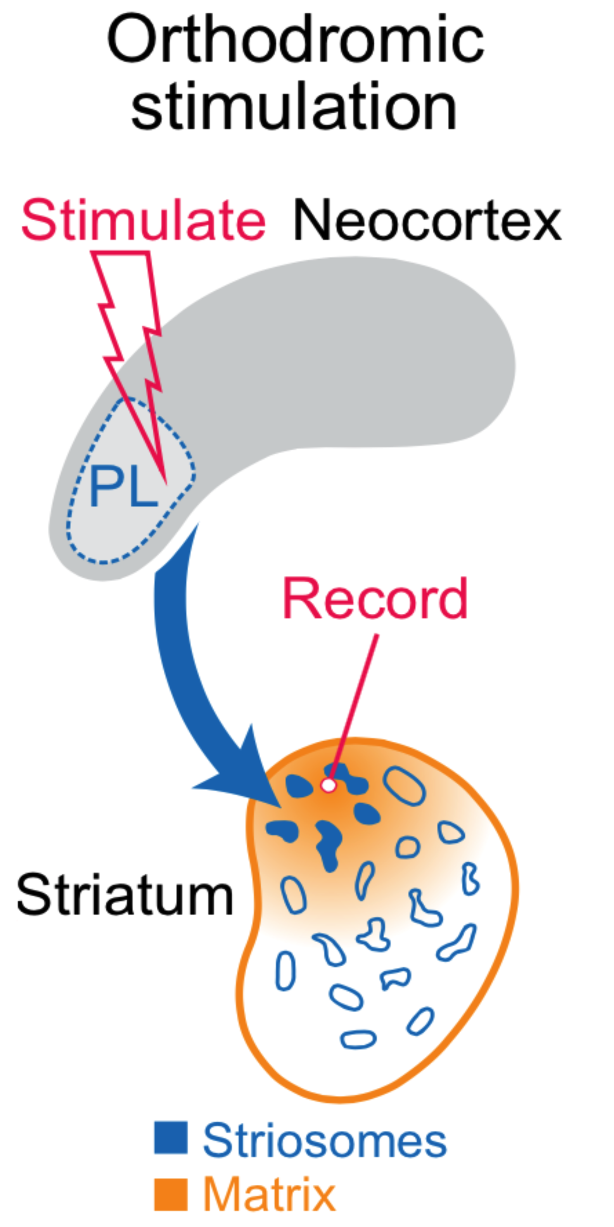
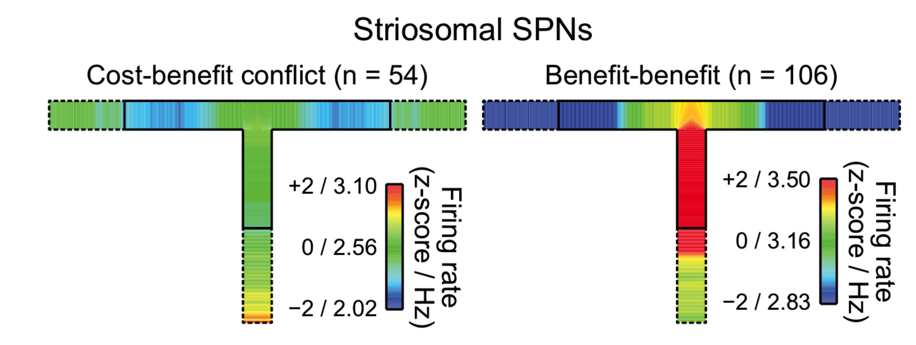
Striosomal SPN Firing Patterns Are Opposite to Those of the Corticostriatal PFC-PLs Neurons

Slide 9
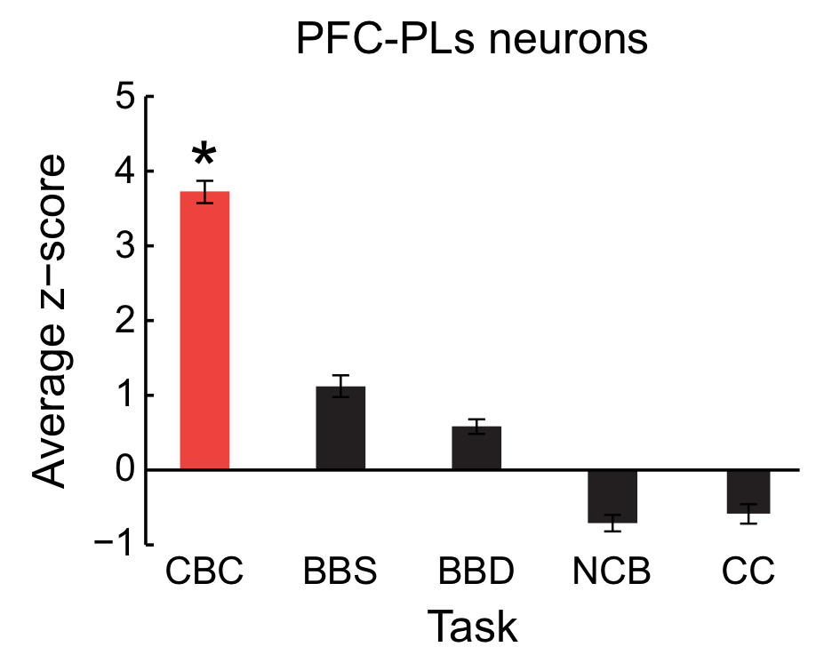
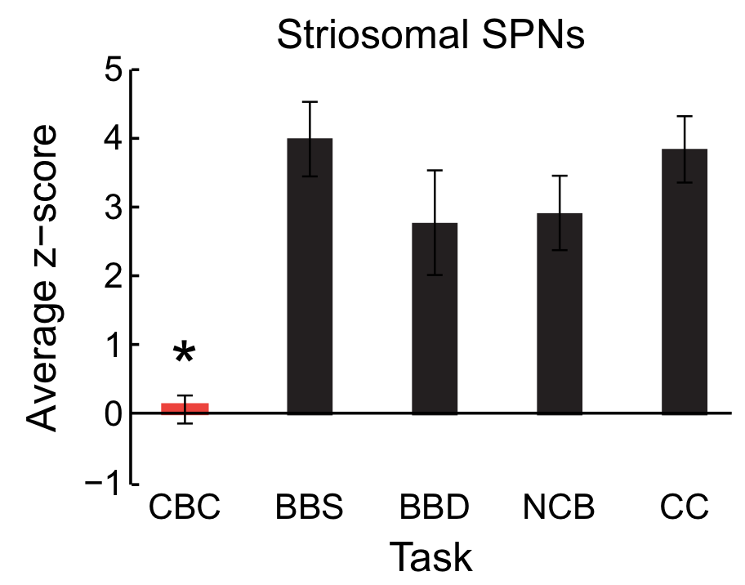
Quantification of Firing Patterns Confirms Complementary Patterns
?
Friedman et al., Cell (2015)
Notes:
Show how they are complementary
Explain Question. And that don’t make any physiological sense

Slide 10
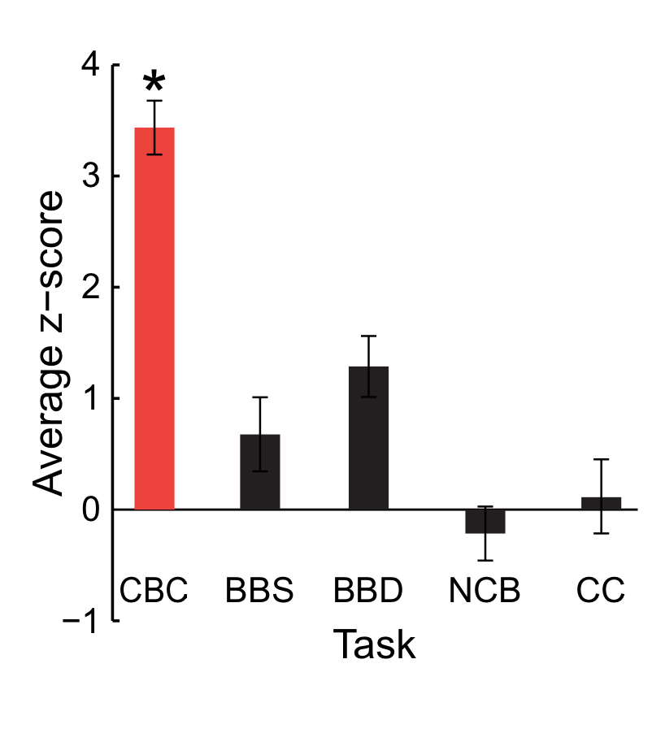
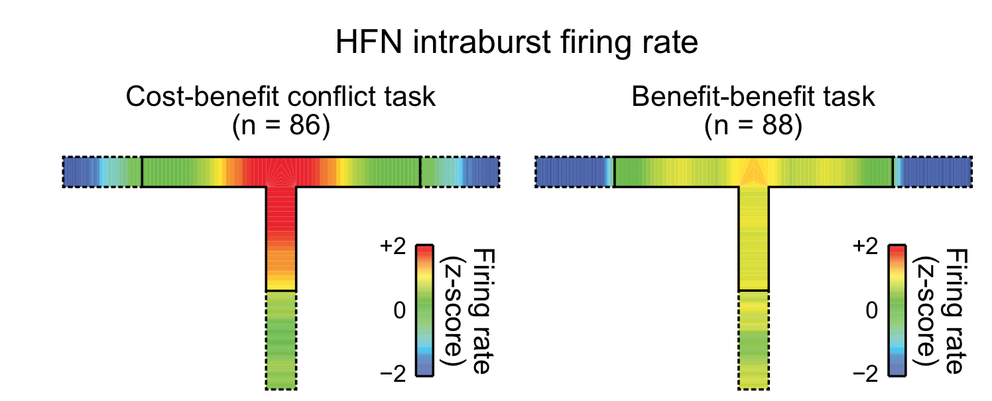
Striatal High-Firing Neurons Have Burst-like Activity Patterns During the Runs That Mimic the Cortical PFC-PLs Patterns
Friedman et al., Cell (2015)

Slide 11
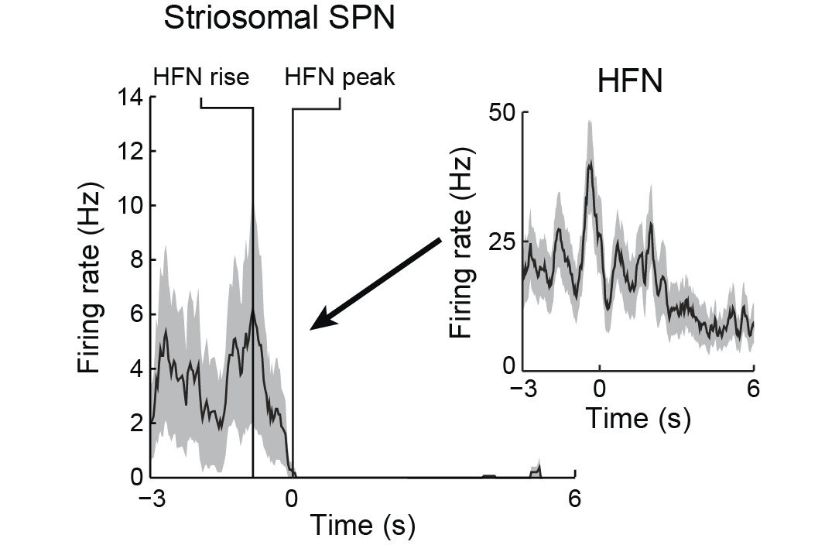
High Firing Interneurons are Inhibiting Striosomal Neurons
Notes:
Remind about empitrical observation that one burst of HFN can inhibit SPN for a seconds
11

Slide 12
Feed Forward Inhibition of Cortico-Striosomal Circuit
Medial
Prefrontal
Cortex
HFN
Dorsomedial
Striatum
SPN
Excitation
Inhibition
Friedman et al., Cell (2015)
Notes:
We demoprefronto striatal cviruit is criticly involved ,,,

Slide 13
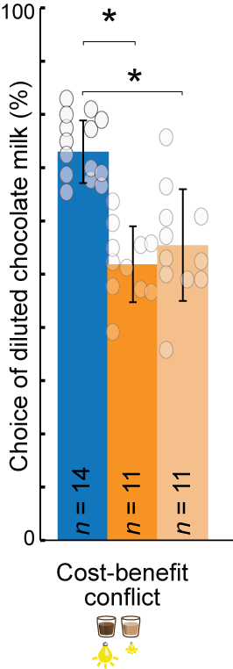
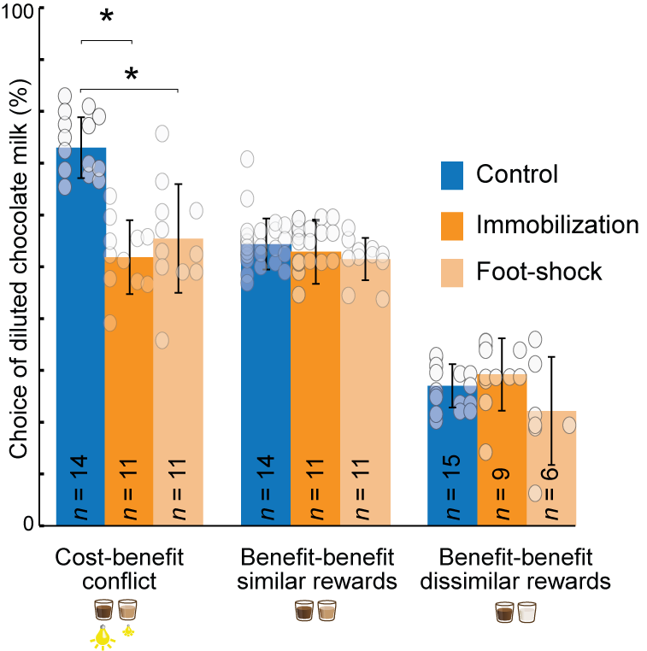
Chronic Stress Causes Abnormal Evaluation of Cost-Benefit
NORMAL
STRESSED
Friedman et al., Cell (2017)
Notes:
Then we ask may be balance between exs and inhibition pasways happens naturally. Indeed it happens after chronic stress we many of us are constantly deal with. ….
13

Slide 14
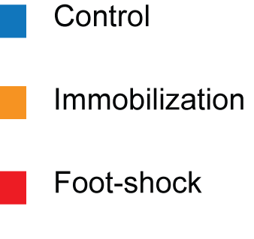
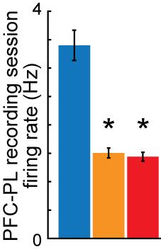
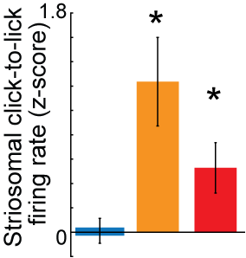
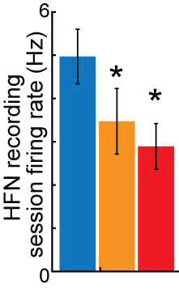
No Feed Forward Inhibition after Chronic Stress
Excitation
Medial Prefrontal
Cortex
Inhibition
HFN
Dorsomedial
Striatum
SPN
PFC activity
decreased
Striosomal SPN
activity increased
HFN activity
decreased
Notes:
Based on literature ….
PL is disabled .
Then we untisipate a Striatum disabled
But surpringly u can do electricity out of striosomes
We decide to check HFNs
They are down
We sugget that may be stress effects HFN more therefore even with lover Pl activity we still ghave more S activity because of lack of feadfard inhibition then we decide to test this

Slide 15
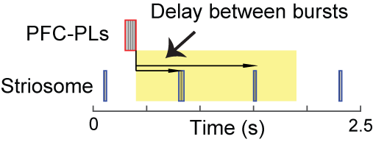
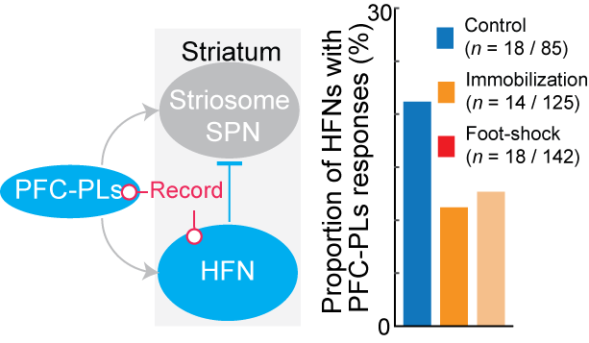
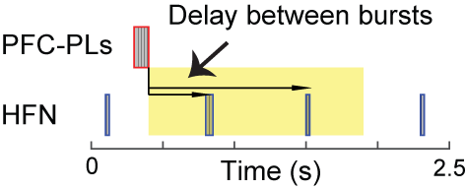
Chronic Stress Alters PFC-PLs - Striatal Functional Connectivity
Functional connected pairs of neurons
Friedman et al., Cell (2017)
Notes:
Look for pairs
Find functionaly cionected
We define FC as a pairs with high probability of Striosome burst follow PFC burst
Then vice versa
15

Slide 16
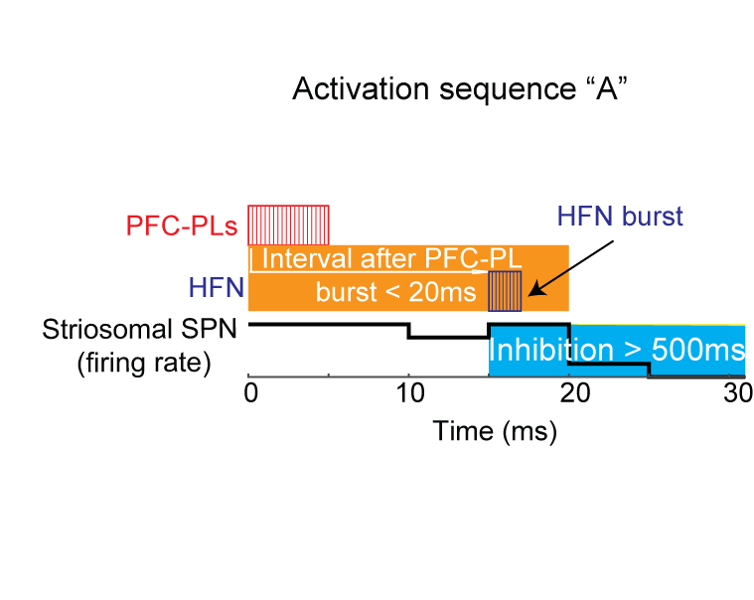
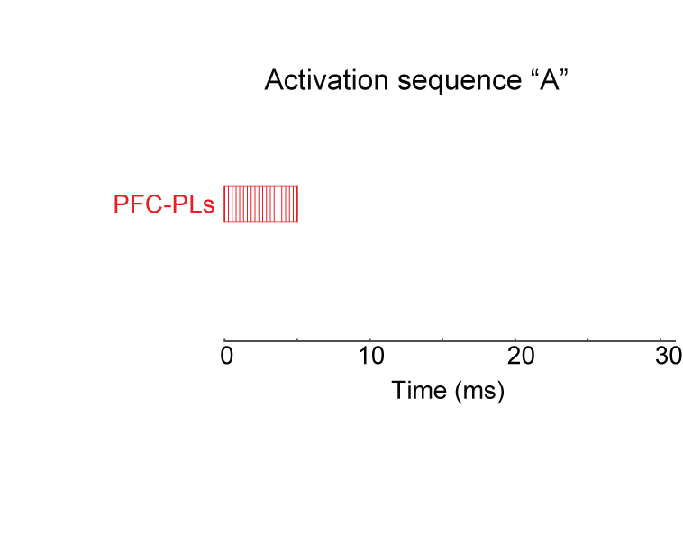
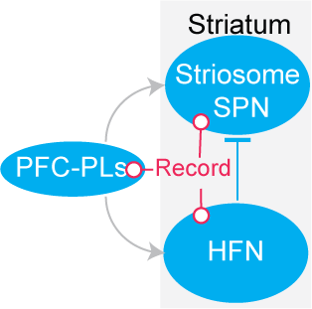
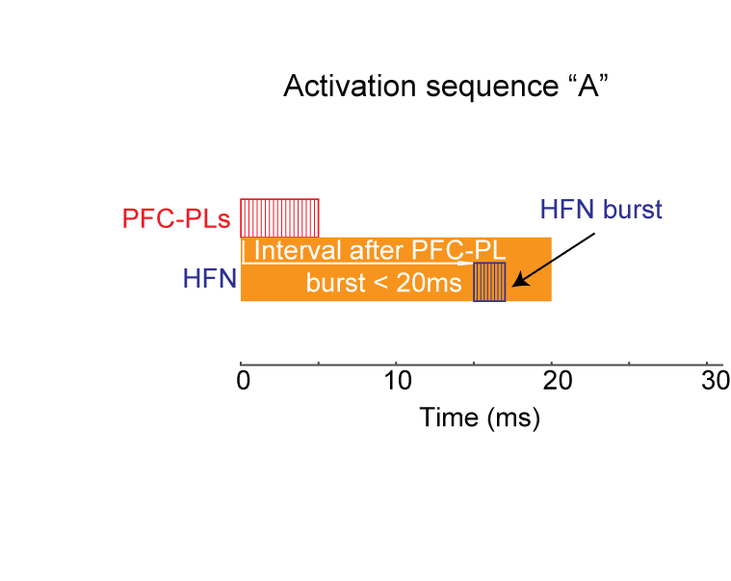
Chronic Stress Reduce Striatal Feed Forward Inhibition and Change Excitation-Inhibition Balance
Friedman et al., Cell (2017)
Notes:
Finally we want to find more direct evidence of pattern activation of PFC-PL striosomal HFN circuit. We search for two activity patterns. A) PFC-PL activate first and HFN is active shorty thereafter and in the end striosomal neuron is inhibited. B) PFC-PL is active and striosomes are active after and HFN is active after striosomes or not active at all.
We find a significantly more patterns of the first type in control animals. And we find much more of second pattern examples in a stressed animals. Again suggesting a shift of E-I balance toward excitation.
Finally we decided to exsimine what is a most critical effect of stress on this circuit using modeling approach.
16

Slide 17
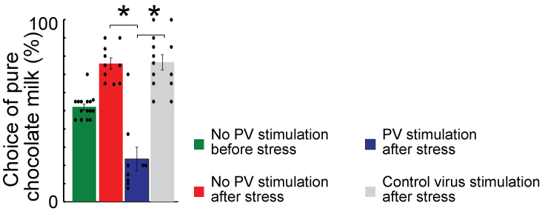
We can Block the Effects of Chronic Stress by Optogenetically Stimulating Striatal HFNs
Medial
Prefrontal
Cortex
HFN
Dorsomedial
Striatum
SPN
Excitation
Inhibition
Notes:
We also applay optogenetic styimulation to resque effect of stress …

Slide 18
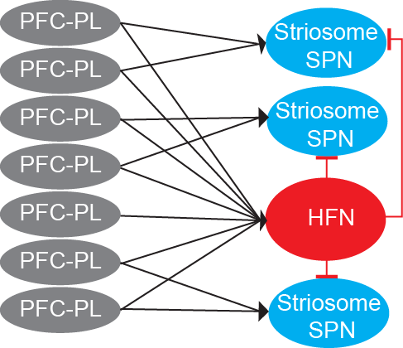
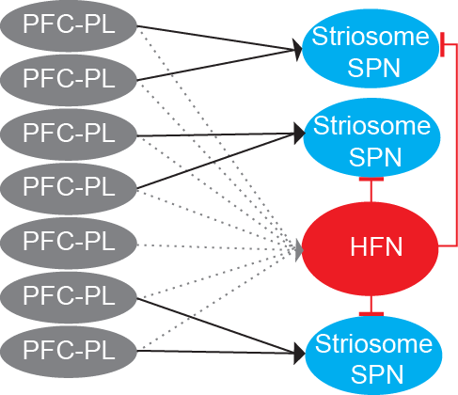
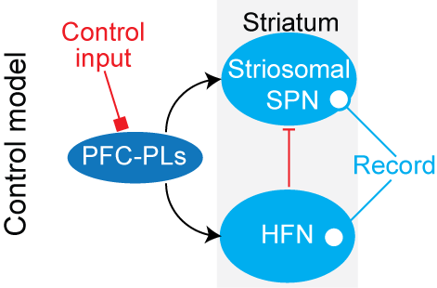
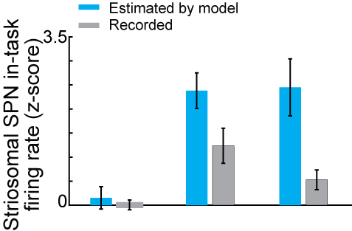
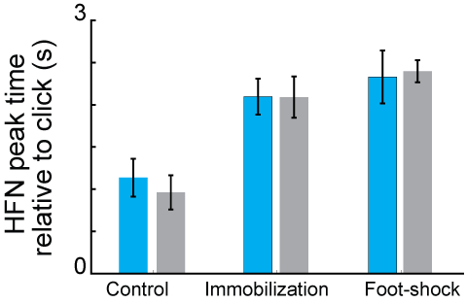
Modeling: Chronic Stress Change Excitation-Inhibition Balance of Cortico-Striosomal Circuit
Notes:
We created a several model of the circuit using HH method. In our model 7 pl neurons were connected with one HFN and 3 striosomal neurons. We develop 4 models of the after stress circuit. In witch we have only one assumption of the E-I shift. We also develop many possible control models that do not have E-I shift.
We inputted to our models with measured PFC-PL activity from control and stressed rats. All models that have a E-I shift were capable to reprodse a exsperimintal obtained result- striosomal hyperactivity and delayed in task HFN activity. However model that not have a E-I shift fail to fully replicate this.
We collectively conclude that chronic stress selectively effect a cost-benefit decision making via shift of E-I balance of cortico-striosomal circuit.
This work has grate significance for other disorders that effect decision making and striatal circuit .

Slide 19
Modeling: Chronic Stress Change Excitation-Inhibition Balance of Cortico-Striosomal Circuit
Notes:
We created a several model of the circuit using HH method. In our model 7 pl neurons were connected with one HFN and 3 striosomal neurons. We develop 4 models of the after stress circuit. In witch we have only one assumption of the E-I shift. We also develop many possible control models that do not have E-I shift.
We inputted to our models with measured PFC-PL activity from control and stressed rats. All models that have a E-I shift were capable to reprodse a exsperimintal obtained result- striosomal hyperactivity and delayed in task HFN activity. However model that not have a E-I shift fail to fully replicate this.
We collectively conclude that chronic stress selectively effect a cost-benefit decision making via shift of E-I balance of cortico-striosomal circuit.
This work has grate significance for other disorders that effect decision making and striatal circuit .

Slide 20
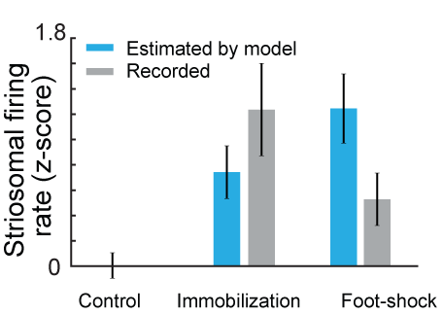
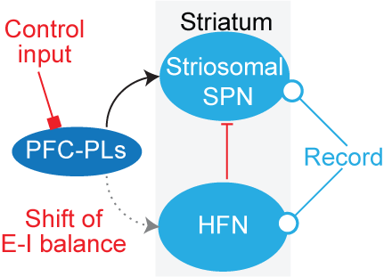
Just Shift of E-I Balance Predicts Striosomal Hyperactivity
Notes:
We created a several model of the circuit using HH method. In our model 7 pl neurons were connected with one HFN and 3 striosomal neurons. We develop 4 models of the after stress circuit. In witch we have only one assumption of the E-I shift. We also develop many possible control models that do not have E-I shift.
We inputted to our models with measured PFC-PL activity from control and stressed rats. All models that have a E-I shift were capable to reprodse a exsperimintal obtained result- striosomal hyperactivity and delayed in task HFN activity. However model that not have a E-I shift fail to fully replicate this.
We collectively conclude that chronic stress selectively effect a cost-benefit decision making via shift of E-I balance of cortico-striosomal circuit.
This work has grate significance for other disorders that effect decision making and striatal circuit .

Slide 21
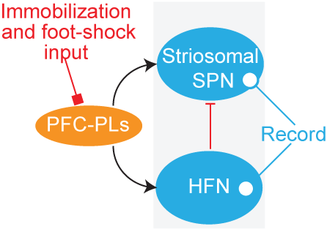
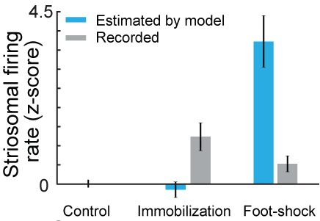
Just PFC-PLs Activity After Stress Does Not Predict Striosomal Hyperactivity
Notes:
We created a several model of the circuit using HH method. In our model 7 pl neurons were connected with one HFN and 3 striosomal neurons. We develop 4 models of the after stress circuit. In witch we have only one assumption of the E-I shift. We also develop many possible control models that do not have E-I shift.
We inputted to our models with measured PFC-PL activity from control and stressed rats. All models that have a E-I shift were capable to reprodse a exsperimintal obtained result- striosomal hyperactivity and delayed in task HFN activity. However model that not have a E-I shift fail to fully replicate this.
We collectively conclude that chronic stress selectively effect a cost-benefit decision making via shift of E-I balance of cortico-striosomal circuit.
This work has grate significance for other disorders that effect decision making and striatal circuit .

Slide 22
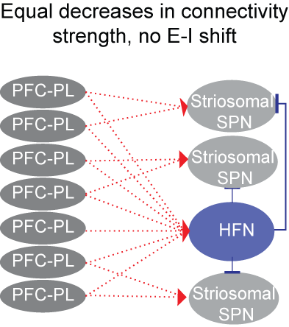
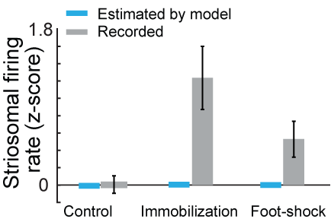
Model Without Shifted E-I Balance Does Not Predicts
Striosomal Hyperactivity
Notes:
We created a several model of the circuit using HH method. In our model 7 pl neurons were connected with one HFN and 3 striosomal neurons. We develop 4 models of the after stress circuit. In witch we have only one assumption of the E-I shift. We also develop many possible control models that do not have E-I shift.
We inputted to our models with measured PFC-PL activity from control and stressed rats. All models that have a E-I shift were capable to reprodse a exsperimintal obtained result- striosomal hyperactivity and delayed in task HFN activity. However model that not have a E-I shift fail to fully replicate this.
We collectively conclude that chronic stress selectively effect a cost-benefit decision making via shift of E-I balance of cortico-striosomal circuit.
This work has grate significance for other disorders that effect decision making and striatal circuit .

Slide 23
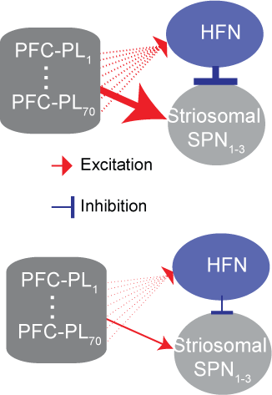
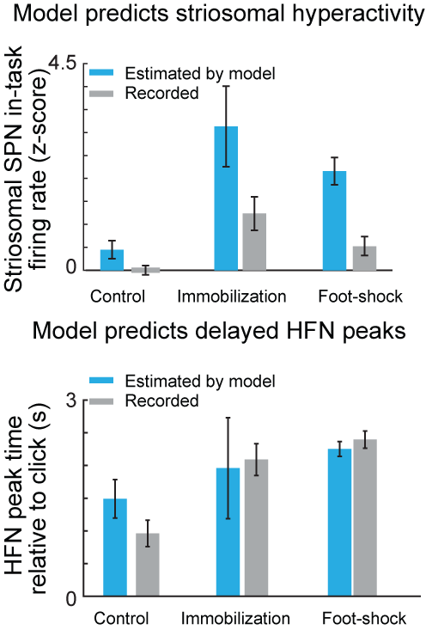
Equal Decreases in Connectivity Strength, With Floor Effect for HFN,- Predicts Striosomal Hyperactivity and Delayed HFN peaks
Notes:
We created a several model of the circuit using HH method. In our model 7 pl neurons were connected with one HFN and 3 striosomal neurons. We develop 4 models of the after stress circuit. In witch we have only one assumption of the E-I shift. We also develop many possible control models that do not have E-I shift.
We inputted to our models with measured PFC-PL activity from control and stressed rats. All models that have a E-I shift were capable to reprodse a exsperimintal obtained result- striosomal hyperactivity and delayed in task HFN activity. However model that not have a E-I shift fail to fully replicate this.
We collectively conclude that chronic stress selectively effect a cost-benefit decision making via shift of E-I balance of cortico-striosomal circuit.
This work has grate significance for other disorders that effect decision making and striatal circuit .

